Slide 1



Research ethics in the Third Sector
…or why one size really doesn’t fit all
Simon Anderson (Simon Anderson Consulting/AHRECS)
Dr Amy Calder (YouthLink Scotland)
The national agency for youth work

Slide 2
Research and research ethics in the third sector: how might it be different?
General concern with values and relationships but no established culture of ethics review (or attention to research ethics more generally)
  Halo effect?
Projects typically smaller and timescales shorter than in academia/healthcare
  Pressure to complete rather than comply?
Greater proximity to policy and practice and general blurring of functions and roles
  e.g. researcher/practitioner; research/evaluation/participation/’lived experience’
But lots of ethically challenging topics and potential vulnerabilities

Slide 3
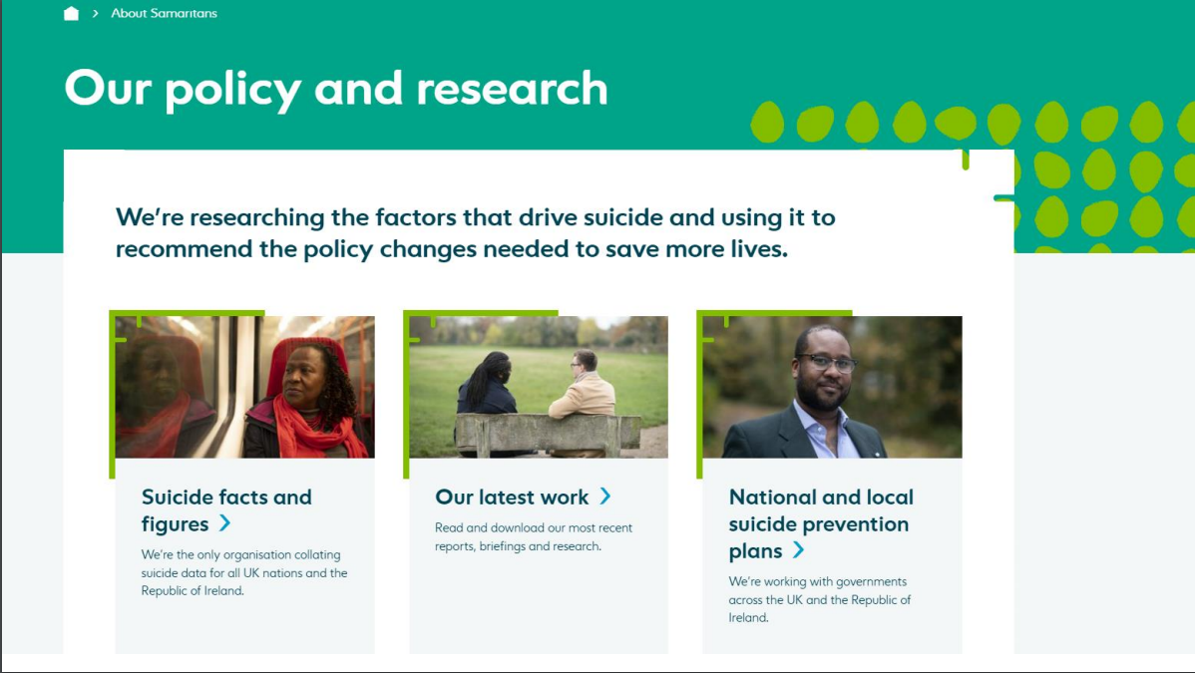

Slide 4
Case study: Samaritans
Longstanding commitment to research and evidence use
Formal research agenda, but also lots of ‘research-like’ activities
Basic research ethics policy since around 2009
Revised policy in 2018 and introduction of Samaritans Research Ethics Board – with commitment to review
AHRECS review and agreed ‘blueprint’ in 2021

Slide 5
What was working well
Clear organisational commitment to values-based policy and practice
Scale of the organisation allowed person-to-person discussion of ethics issues and challenges
Responsiveness and quality of advice offered by the research team
Recruitment of committed, capable reviewers to the SREB, offering effective scrutiny and valued feedback – especially for ‘traditional’ research
Effective administration and manageable workload for SREB members
Commitment to reflection and improvement

Slide 6
What was working less well
Ethics review working less well for new types of projects and ways of working – e.g. ‘Ux’ and service development, comms, marketing
Relevance of ethics not always clear, and concern about the process being unwieldy, time consuming or unnecessarily restrictive
Perceived lack of consistency and transparency in decision-making
‘Culture gap’ between SREB and non-research staff, and concern about risk aversion
Risk of research team being seen as imposing ethics on wider organisation – ‘ethics police’ not ‘facilitation champions’

Slide 7
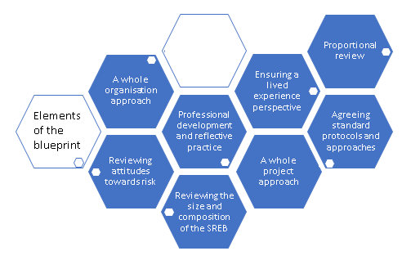

Slide 8


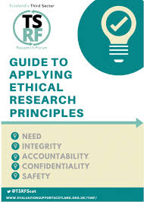
Context
Senior Researcher at YouthLink Scotland, the national agency for youth work
Can only gain ethical approval for research when partnering with universities or with other organisations that require it
In 2021 Third Sector Research Forum developed a Guide to Applying Ethical Research Principles

Slide 9

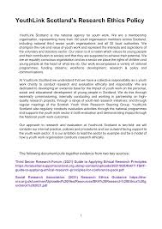

Developing a policy to navigate research and evaluation ethics
Scottish Government Analytical Exchange programme – to develop a YouthLink Scotland research ethics policy
Using the language of research and evaluation
Provides a checklist of ethical considerations
Sets our expectations when commissioning, conducting and working in partnership on research and evaluation

Slide 10

Supporting and reflecting
Research ethics is not just about ethical approval and box ticking
It’s about reflective practice and supporting each other
Informal research ethics group – for third sector researchers to meet online every 6-8 weeks
Developing a research ethics appraisal service?

Slide 11
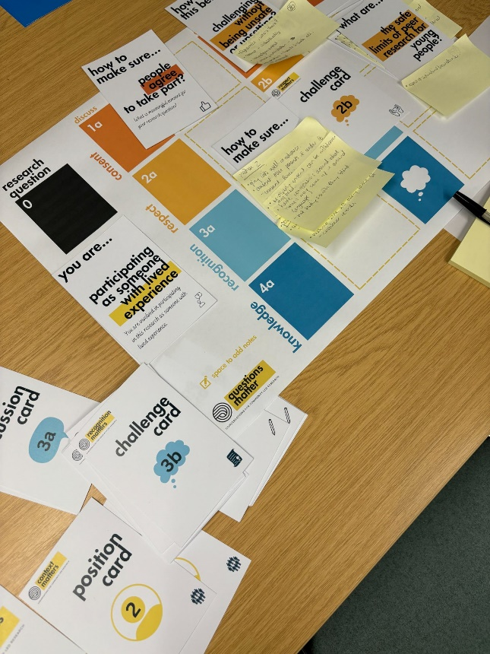



Participatory ethics toolkit
Community Knowledge Matters
A network that brings together people interested in community-led research shaping practice & policy change in mental health and wellbeing in the H&I and beyond
Developed a participatory ethics toolkit – prompt conversations around ethical decisions in community-led research

Slide 12
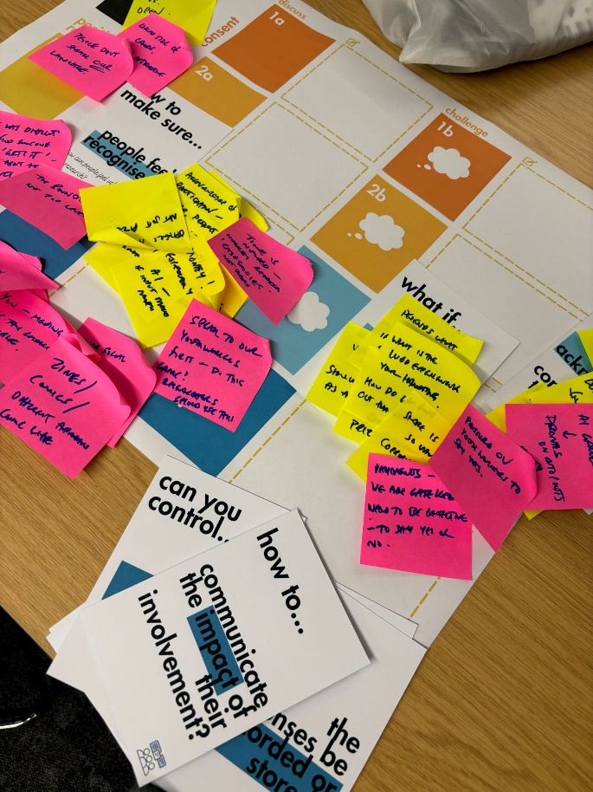



Rights-respecting approach to ethics
Who gets to set the terms of engagement around research?
How can we make university ethics processes more accessible and fairer to communities?
How can we develop ethics processes outside of universities that community-based (/peer) researchers can access?
How can we allow communities to have a say on how they would like to engage with research (ie. the ethical considerations)?

Slide 13

Next steps
Third sector researchers are adept at navigating ethics
Avoid the pitfalls of ticking boxes
Use more relational, reflective and participatory approaches
Learn the lessons from other sectors
Develop ethics which ensures that the participants and researchers wellbeing is at the heart

Slide 14
Contacts and links
simon@simonanderson.consulting
ACalder@youthlink.scot
www.ahrecs.com
https://www.samaritans.org/scotland/about-samaritans/research-policy/

