Slide 1
Research integrity and research culture in the third sector
Lindsay Judge, Research Director
December 2024

Slide 2
What do we mean by research integrity?
4 key principles
  Rigour
    In gathering, storing and sharing data
  Transparency
    In research methods
    Declarations of interest
  Care and respect for research participants
    Do no harm
  Honesty
    Reporting results
    Citing other work
    Admitting to mistakes

Slide 3
Why is research integrity important?
Formal reasons
  RF is a UKRI and abiding by the highest research standards is a mandatory requirement
  We have a number of policies that encode these standards

Slide 4
Why is research integrity important?
Formal reasons
  RF is a UKRI and abiding by the highest research standards is a mandatory requirement
  We have a number of policies that encode these standards
Ethical reasons
  Chaotic research processes, misrepresentation -> poor culture, staff retention
  ‘Do no harm’ to research participants

Slide 5
Why is research integrity important?
Formal reasons
  RF is a UKRI and abiding by the highest research standards is a mandatory requirement
  We have a number of policies that encode these standards
Ethical reasons
  Chaotic research processes, misrepresentation -> poor culture, staff retention
  ‘Do no harm’ to research participants
Impact reasons
  RF’s impact stems from the quality and replicability of our research

Slide 6
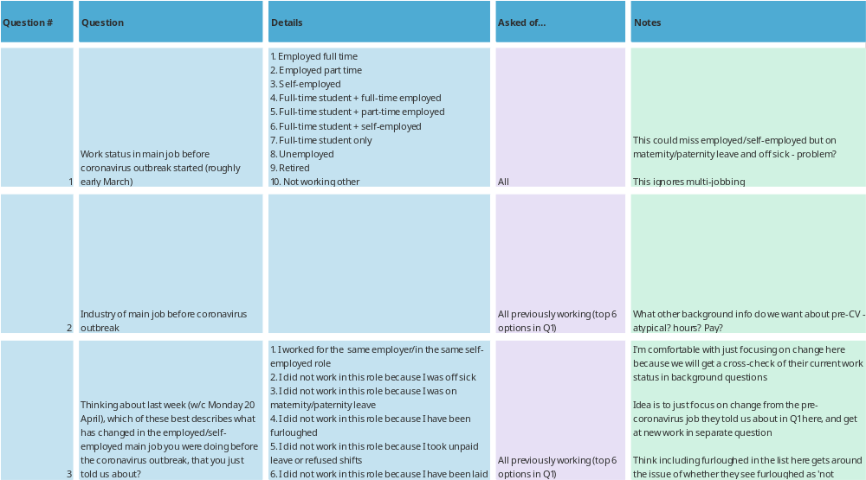
Putting rigour into practice: An example
Snip of RF Covid-19 survey: May 2020

Slide 7
Putting rigour into practice: An example
When designing and fielding surveys….
Think v hard about what you actually want to know/report
Take advice from survey design experts
Try ask qs that are similar to those in published surveys so can sense check
Think about samples/weighting
Publish the underlying data if possible
Snip of RF Covid-19 survey: May 2020

Slide 8
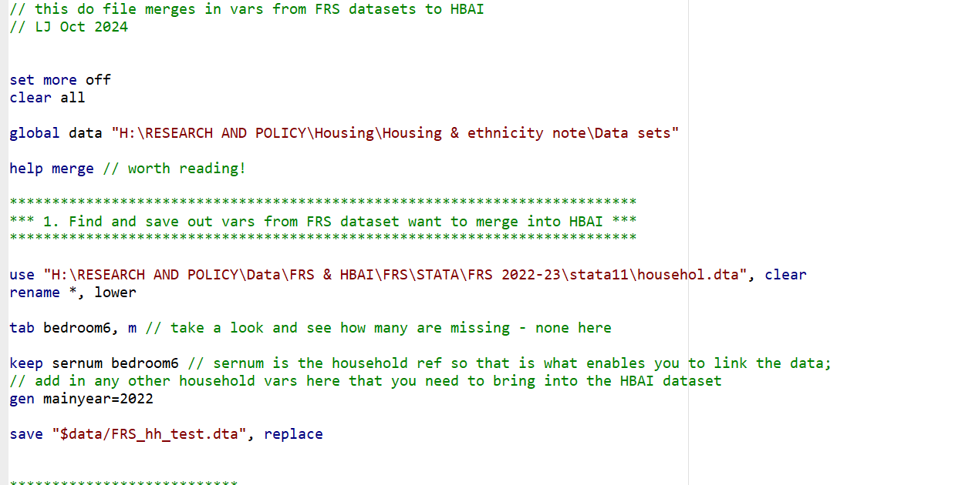
Putting transparency into practice: An example
Snip from RF do file: Oct 2024

Slide 9
Putting transparency into practice: An example
Snip from do file: Oct 2024
When undertaking research…
Replicability is key
Make sure method and assumptions are written down
Have a formal QA process where work is checked by others
Check results with other published work/experts in the field

Slide 10
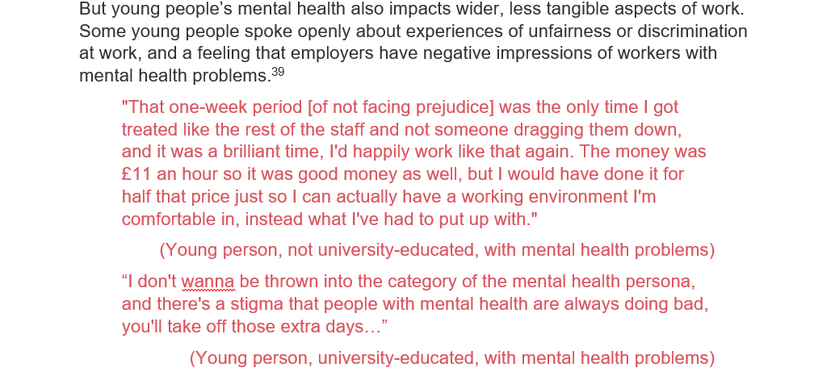
Putting care and respect into practice: An example
Snip from RF report on young people with mental health problems: February 2024
Source: C McCurdy & L Murphy, We’ve only just begun: Action to improve young people’s mental health, education and employment, Resolution Foundation, February2024

Slide 11
Putting care and respect into practice: An example
When undertaking qualitative research…
Be clear with participants about the purpose
Get written consent and file
Take advice from experts/seniors
Be sensitive/know when to push and when to stop
Anonymise/store data in secure folder/destroy on competition
Snip from report on young people with mental health problems: February 2024
Source: C McCurdy & L Murphy, We’ve only just begun: Action to improve young people’s mental health, education and employment, Resolution Foundation, February2024

Slide 12
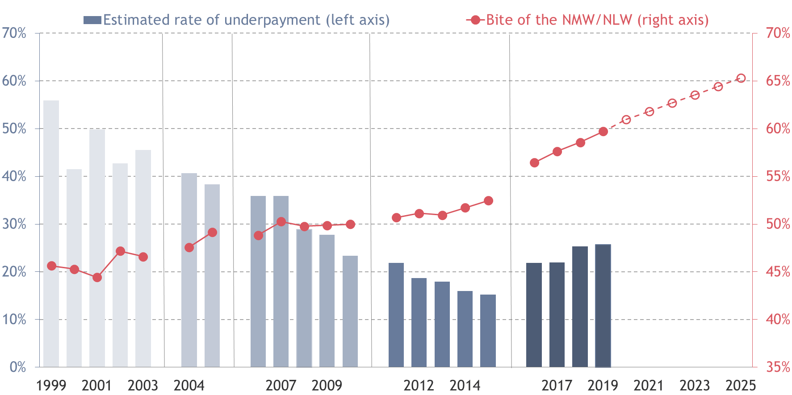
Putting honesty into practice: An example
Proportion of workers paid or close to NMW that are underpaid (left axis) and 'bite’ (right axis)
Notes: Different methods used to calculate underpayment rates 1999-2002, 2003-2005, 2006-2010 and 2011 onwards. Data for 2016-2018 are for different points in the minimum wage year than all other years, so cannot be directly compared. ‘Bite’ is NMW relative to median hourly wage for April of relevant year.
Source: Low Pay Commission analysis of ONS, Annual Survey of Hours and Earnings, 2000-2016, RF analysis of ONS, Annual Survey of Hours and Earnings, 2017-2019

Slide 13
Putting honesty into practice: An example
Proportion of workers paid or close to NMW that are underpaid (left axis) and 'bite’ (right axis)
Notes: Different methods used to calculate underpayment rates 1999-2002, 2003-2005, 2006-2010 and 2011 onwards. Data for 2016-2018 are for different points in the minimum wage year than all other years, so cannot be directly compared. ‘Bite’ is NMW relative to median hourly wage for April of relevant year.
Source: Low Pay Commission analysis of ONS, Annual Survey of Hours and Earnings, 2000-2016, RF analysis of ONS, Annual Survey of Hours and Earnings, 2017-2019

Slide 14
Putting honesty into practice: An example
When reporting results
Be very clear about what you are showing
Always include data source
Cite others research i.e. don’t claim other’s results
Include an annex on method where appropriate
Own any ambiguity
Proportion of workers paid or close to NMW that are underpaid (left axis) and 'bite’ (right axis)
Notes: Different methods used to calculate underpayment rates 1999-2002, 2003-2005, 2006-2010 and 2011 onwards. Data for 2016-2018 are for different points in the minimum wage year than all other years, so cannot be directly compared. ‘Bite’ is NMW relative to median hourly wage for April of relevant year.
Source: Low Pay Commission analysis of ONS, Annual Survey of Hours and Earnings, 2000-2016, RF analysis of ONS, Annual Survey of Hours and Earnings, 2017-2019

Slide 15
Making sure things don’t go wrong … And what to do when they do
Creating a culture of research excellence means…
  Codifying policies and procedures
  Explaining why it is important to staff, providing appropriate support
  Accountability is key – where does responsibility sit
  The more eyes the better – share, QA, check with externals
When mistakes are made…
  Own them immediately – withdraw the research if necessary; if publish a corrected version make clear how and when it was corrected
  Investigate why the mistake happened – and put in place processes to reduce risk of a repeat
  Consider if amounts to misconduct and take steps if so
Notes:
(falsification, fabrication, misrepresentation, failure to report errors, plagiarism, unacknowledged appropriation, failure to follow legal, ethical or other requirements
Things that are not misconduct include:
genuine error (other than gross negligence)
poor quality research
Interpretation of results

Slide 16
Research integrity and research culture in the third sector
Lindsay Judge, Research Director
December 2024

